Slide 1
Intermediate Analytics ALY6015 Lecture 3: Linear Model Selection and Regularization

Slide 2
Administrative Notes
Discussions and assignments expectations
For discussions, make sure that you reply to two other classmates’ main posts.
It is essential that you submit your R code under the proper assignment sections each week, in .R file format.
Please don’t print out the whole dataset and paste it into your report!
Remember: the reader is not your professor; the reader is someone interested in a serious analysis.

Slide 3
Administrative Notes
Discussions and assignments expectations
No need to explain your R code to me in the report unless you are confused about the code and need to explain what you were thinking.
Including comments within the body of the code will help me understand your thinking, but this is not part of the analysis.
We are focused on statistical understanding and tying that statistical understanding to an interpretation of the data that can lead to a real-world conclusion or course of action.

Slide 4
Assignment Guidance
Don’t: Treat assignments like a set of math problems. Assignments are in report format for a reason.
Do: Refer carefully to the rubrics for writing expectations.
“Analysis: Provides all R code and the outputs. Includes interpretation of the output, graphs, figures, charts, and tables and the significance of the results in the analysis.”
“Data Viz: Data visualizations are appropriate for the level and type of analysis. Graphs, figures and tables communicate insights and significance to the reader.”
“Interpretation: The conclusion summarizes and makes sense of the results, making good points that reflect clear understanding of the assignment material.”

Slide 5
Assignment Guidance
Don’t: Use up words to explain R code.
“First, we load packages using the library() function. Then, we load the dataset using the read.csv() command, which reads CSV files. Next, we will use the head() function to print the head of the dataset.”
Do: Reference the name of the statistical test you intend to perform or the chart you intend to create.
“We produce a scatter plot below, allowing us the visualize the clear positive linear relationship between marketing budget and sales.”
“We perform an F-test in order to examine the difference in variance between male and female cat weights as represented in this data set.”

Slide 6
Assignment Guidance
Don’t: Include large blocks of code or output with no interpretation.
>t = -1.8948, df = 93.357, p-value = 0.06121 alternative hypothesis: true difference in means is not equal to 1 95 percent confidence interval: -1.141963 1.050160
Do: Include code or outputs that you intend to directly interpret for the reader. It should be clear WHY you showed the reader this code.
“I intend to use a two-sided t-test to determine whether there is evidence to support the hypothesis that the body weight of male and female cats on average is not equal. This test is appropriate because [insert reason]. >t.test(male$weight, female$weight, paired=T)

Slide 7
Assignment Guidance
Don’t: Say that you “accept” a hypothesis, or that you have “proven” something.
“We find that the p-value is greater than 0.05, so we accept the null hypothesis, which proves that male and female cats do have the same average body weight.”
Do: Say that you “reject” or “fail to reject” a hypothesis. Say that you “find evidence to support” a conclusion.
“We find p<0.05, and therefore we can reject the null hypothesis, indicating that we find evidence that on average male and female cats do not have the same body weight.”
“With a p-value greater than our alpha level of 0.05, we must fail to reject the null hypothesis. We find no evidence to conclude that male and female cats do not have the same mean body weight.”

Slide 8
Assignment Guidance
Don’t: Perform analyses without stating your objective.
”Now we do a one-sided t-test” >t.test(male$weight, female$weight, paired=T, alternate=‘greater’)
Do: State your null and alternate hypotheses; state the specific question you are addressing with an analysis.
We would like to determine whether male cats have a greater body weight on average than females. Therefore, we hypothesize that H_0: (Male weight – female weight) = 0 H_A: (Male weight – female weight) >= 0 >t.test(male$weight, female$weight, paired=T, alternate=‘greater’)
This applies to ALL questions you investigate, not just hypothesis testing!

Slide 9
Course Tracker
Descriptive statistics in R (Week 1)
Graphical representation of data in R (Week 1)
Inferential statistics in R (Week 2)
Hypothesis testing (Week 2)
Regression Analysis (Week 2)
Regularization and Lasso Modeling (TODAY)
Data Mining (Week 4)
Clustering and Classification (Week 4)
Time Series Forecasting (Week 5)
Bringing it all together – Group Project (Week 6)

Slide 10
Lecture Part 1 Linear Model Selection

Slide 11
Last Week: Simple Linear Regression
A simple linear equation in most cases cannot perfectly predict dependent variable from independent variable —even though there is a large positive correlation.
Hence, we add an error variable epsilon, **ε**, to the equation, which is the error of measuring Y from X:
**Y = a + bX + ε**
This model is non-deterministic and it allows for errors of prediction

Slide 12
Extension: Multiple Linear Regression
Similarly, we can add multiple independent variables in order to estimate the dependent variable
**Y = a + b1X1 + b2X2 + b2X2 + … + bpXp + ε**
We will refer to the number of independent variables (or predictors) as p and the number of data points in our sample as n

Slide 13
Generalization: Practical Machine Learning
Linear regression is among the simplest models among a wide variety of models for prediction
We used R to leverage computing power to generate predictor estimates as confidence intervals – leveraging computing power to develop statistical models can be referred to as “machine learning”
Machine learning is a field of computer science that gives computers the ability to learn without being explicitly programmed. Machine learning is closely related to (and often overlaps with) computational statistics, which also focuses on prediction-making through the use of computers.
Examples: Uber's rider demand, Gmail's spam filter, etc.
Can you think of other examples?

Slide 14
Linear Regression and Ordinary Least Squares
As we discussed last week, to run a Linear Regression we use one of its most simplest methods: Ordinary Least Squares (OLS). The goal of OLS is to closely "fit" a function (the line) with the data (points on the line) as closely as possible. It does so by minimizing the sum of squared errors from the data.
When using OLS we draw a line, and then for each of the data points, measure the vertical distance between the point and the line, square it, and add these up; the fitted line would be the one where this sum of distances is as small as possible.

Slide 15
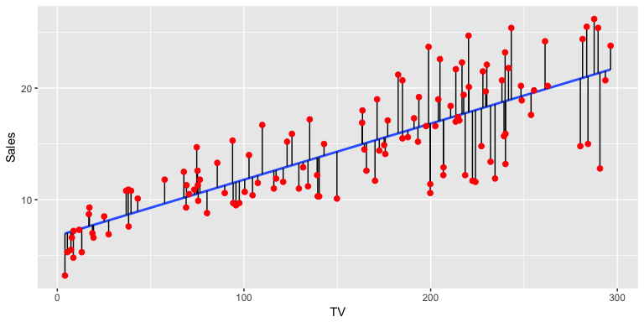
Linear Regression and Ordinary Least Squares
OLS: Minimize the sum of squares of the vertical distance between a linear function and data points

Slide 16
Limitations of OLS
OLS has many assumptions such as:
there is no multicollinearity (when one predictor variable in a multiple regression model can be linearly predicted from the others with good accuracy.)
the model is linear in parameters (which isn't always the case so causes overfitting - low bias (model isn’t simplified enough) and high variance (model does not generalize to data it hasn’t seen before))
Therefore, OLS is susceptible to overfitting: the production of an analysis that corresponds too closely or exactly to a particular sample of data, and may therefore fail to fit additional data or predict future observations reliably.

Slide 17
Multicollinearity Problem and Evaluation
In the high-dimensional setting (i.e. many predictor variables), the multicollinearity problem is extreme: any variable in the model can be written as a linear combination of all of the other variables in the models.
It is also important to be particularly careful in reporting errors and measures of model fit in the high-dimensional setting.
One should never use sum of squared errors, p-values, R^2 statistics, or other traditional measures of model fit on the training data as evidence of good model fit in the high-dimensional setting.
It is important to report results on an independent test set, or cross-validation errors.

Slide 18
Other Fitting Methods
Thankfully, OLS is not the only method for running linear regression. We can run linear regression with other fitting methods. For example:
You could take the leftmost point and the rightmost point and draw a line between them
You could find the line for which there are an equal number of points above the line and below the line
You could draw a line, and then for each of the data points, measure the vertical distance between the point and the line, and add these up; the fitted line would be the one where this sum of distances is as small as possible (this is a real method and is called least absolute deviations)
We use other fitting methods to make sure we have:
Good Prediction Accuracy
Good Model Interpretability

Slide 19
Bias v Variance: Underfitting and Overfitting
Before we talked about prediction accuracy and model interpretability, we need to talk about **bias** and **variance**. The bias-variance tradeoff is a central problem in supervised learning.
Statistical models have "error" that can be reducible and irreducible. Irreducible error is the inherent uncertainty. Reducible error should be minimized further to maximize accuracy. Reducible error is error due to bias and variance.
**Bias** is an error from erroneous assumptions in the learning algorithm. High bias can cause an algorithm to miss the relevant relations between features and important regularities (underfitting) – the model will be oversimplified.
**Variance** is an error from sensitivity to small fluctuations in the training set. High variance can cause an algorithm to model the random noise in the training data, rather than the intended outputs (overfitting) – the model will not generalize well to unseen data.

Slide 20
Training and Testing Set
Training set: Set of observations used to ‘train’ the model (i.e. build the model and determine estimators)
Test set: Set of observations held out from training set in order to test model accuracy
Test set accuracy is the key to judge a model – there are several techniques such as using a hold out validation set, or cross validation such as k-fold validation, etc. (to be discussed later)
Important concept in building powerful statistical models

Slide 21
Prediction Accuracy
OLS estimates have low bias and low variability especially when the relationship between their response and predictor variables is linear and **n > p**, where n = the number of observations and p = the number of independent variables.
However, if **n** is NOT much larger than **p**, then the OLS fit can have high variance and result in overfitting and poor estimates on unseen observations b/c it is too flexible.
If **p > n** then the variability of the OLS fit also increases and so does the variance of the estimates, thus prediction accuracy suffers again.

Slide 22
Model Interpretability
With large number of **p** in the model, there generally will be many **p** that have little or no effect on the response variable. However, if we include many of these variables, we are introducing complexities to the model thus overshadowing the effect of the important variables, overfitting by introducing random noise, and making it harder to interpret the model's results.
To improve the interpretability, we would need to remove these unimportant variables (by setting the coefficients to zero).

Slide 23
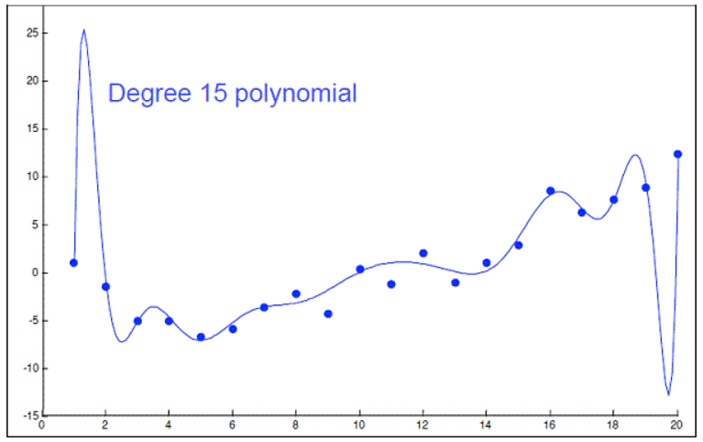
Feature/Variable Selection
Carefully selected features can improve model accuracy and adding too many could lead to overfitting which may:
affect predictive performance of the model on test data
overfitted models confuse random error and noise for underlying relationship
For example we could use a 15-degree polynomial function to fit our data nicely (see example) but this probably won't perform well on a new subset from the population.

Slide 24
Feature/Variable Selection (cont.)
In the feature selection we should know the following procedures:
Subset selection: Identify a subset of the p’s that we believe to be related to the response variable then and fit a model using OLS on the reduced set.
Methods: best subset selection, stepwise selection

Slide 25
Feature/Variable Selection (cont.)
Shrinkage (Regularization)
Involves shrinking the estimated coefficients toward zero relative to the OLS estimates; has the effect of reducing variance and performs variable selection.
Methods: ridge regression, lasso
Dimension Reduction
Involves projecting the p’s into a M-dimensional subspace, where M < p, and fit the linear regression model using the M projections as predictors.
Methods: principal components regression, partial least squares

Slide 26
Best Subsets Selection and Evaluation
Best Subsets compares all possible models using a specified set of predictors, and displays the best-fitting models that contain one predictor, two predictors, and so on. The end result is a number of models and their summary statistics. It is up to you to compare and choose one.
Select single best model among all resulting models using cross-validated prediction error, AIC, BIC, or adjusted R^2.

Slide 27
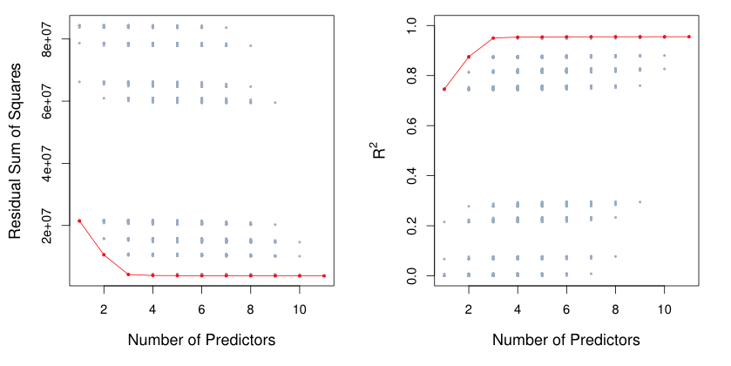
Best Subsets Selection Evaluation Limitations
RSS (residual sum of squares) will always decline and R^2 will always increase as the number of predictors in the model increases (see figure) since these quantities are related to the training error, so neither of these are useful statistics for selecting the best model. Avoid judging your model based on them.

Slide 28
Best Subsets Selection Limitations
While best subset selection is a simple and conceptually appealing approach, it suffers from computational limitations.
The number of possible models that must be considered grows rapidly as p increases.
Best subset selection becomes computationally infeasible for value of p greater than around 40. Hence, for computational reasons, best subset selection cannot be applied with very large p.

Slide 29
Stepwise Selection
More attractive methods include:
Forward Stepwise Selection
Begins with a null OLS model containing no predictors, and then adds one predictor at a time that improves the model the most until no further improvement is possible.
Backward Stepwise Selection
Begins with a full OLS model containing all predictors, and then deletes one predictor at a time that improves the model the most until no further improvement is possible.

Slide 30
Stepwise Selection Evaluation
Select single best model using cross-validated prediction error, AIC, BIC, or adjusted R^2.
The model containing all the predictors will always have the smallest RSS and the largest R^2. We wish to choose a model with low test error, not a model with low training error. Recall that training error is usually a poor estimate of test error.
Thus, RSS and R^2 are not suitable for selecting the best model among a collection of models with different numbers of predictors.

Slide 31
Stepwise Selection Limitations
Both forward and backward stepwise selection approaches can be applied in settings where p is too large to apply best subset selection.
Both of these stepwise selection methods are not guaranteed to yield the best model containing a subset of the p predictors.
Forward stepwise selection can be used even when n < p, while backward stepwise selection requires that n > p.
There is also a hybrid version of these two stepwise selection methods.

Slide 32
Stepwise Selection Example
https://www.statmethods.net/stats/regression.html

Slide 33
Estimating Test Error
We can indirectly estimate test error by making an adjustment to the training error to account for the bias due to overfitting.
We can directly estimate the test error, using either a validation set approach or a cross-validation approach.

Slide 34
Measures of Comparison
To compare different models, we can use the following approaches:
* Adjusted R^2
* AIC (Akaike information criterion)
* BIC (Bayesian information criterion)
* Mallow’s Cp (equivalent to AIC for linear regression)
These techniques adjust the training error for the model size, and can be used to select among a set of models with different numbers of variables.

Slide 35
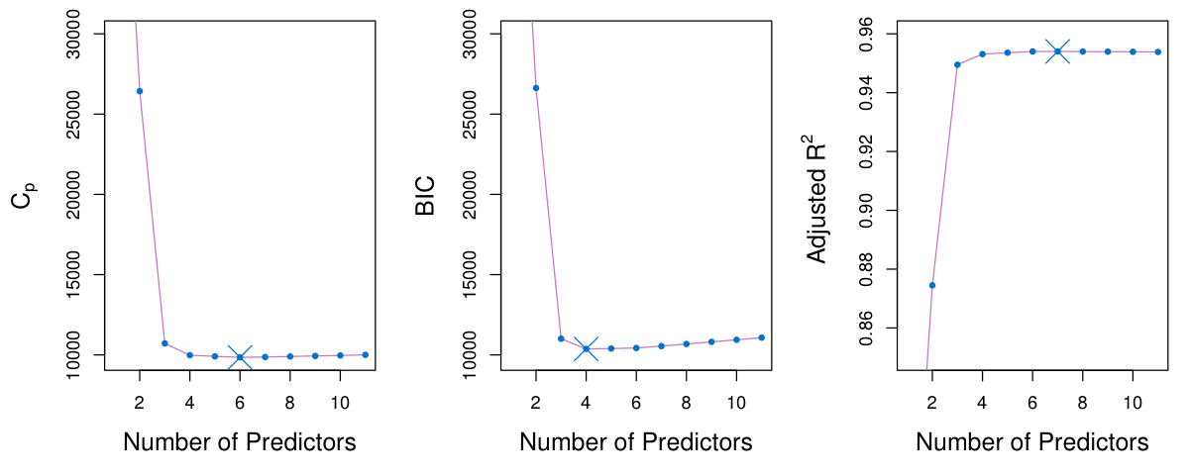
Estimating Test Error
A small value of AIC, Cp, or BIC indicates a low error, and thus a better model.
A large value for the Adjusted R^2 indicates a better model. Unlike others, Adjusted R^2 has a predictable range (0-1).

Slide 36
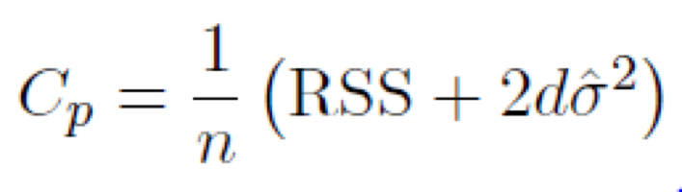
Mallow's Cp (the Bonferroni criterion)
For a fitted OLS model containing d predictors, the Cp estimate of test MSE (mean squared error: average of the squares of the errors or deviations between the estimator and the estimated):
where 𝜎 ̂^2 is an estimate of the variance of the error ε associated with each response measurement and d is the number of predictors.
Cp estimates the bias introduced in the estimates of the responses by having an underspecified model (a model with important predictors missing).

Slide 37
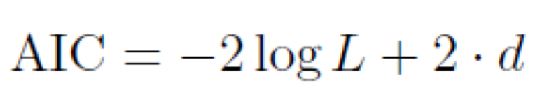
Akaike Information Criterion (AIC)
Here L is the maximized value of the likelihood function for the estimated model and d is number of predictors.
In a linear model, MLE (maximum likelihood estimation) and OLS are the same things, thus, Cp and AIC are equivalent.
Notes:
“Maximum likelihood estimation is a method that determines values for the parameters of a model. The parameter values are found such that they maximise the likelihood that the process described by the model produced the data that were actually observed.”

Slide 38
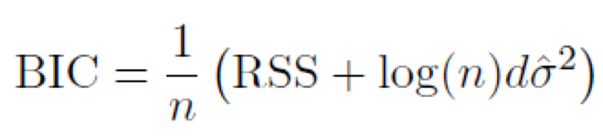
Bayesian Information Criterion (BIC)
BIC replaces the 〖2𝑑𝜎 ̂〗^2 used by Cp with a 〖log(𝑛)𝑑𝜎 ̂〗^2 term, where n is the number of observations.
BIC statistic generally places a heavier penalty on models with many variables, and hence results in the selection of smaller models than Cp.

Slide 39
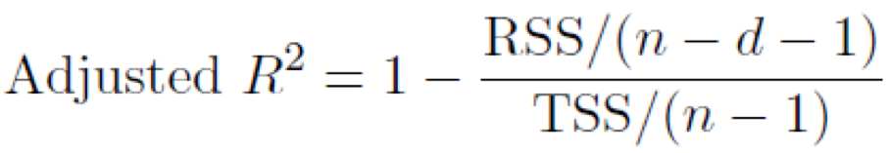
Adjusted R^2
For an OLS model with d variables, the adjusted R^2 is calculated:
where TSS is the total sum of squares
Unlike the other statistics, a large value of adjusted R^2 indicates a model with a small test error. The adjusted R^2 statistics pays a price for the inclusion of unnecessary variables in the model.

Slide 40
Lecture Part 2 Regularization and Dimensionality Reduction

Slide 41
Validation & Cross-Validation
A simple method of validation is to randomly hold out a ‘test set’ of your observations and judge your model accuracy by calculating a goodness of fit test of the model you trained using the test set
A better method is k-fold cross-validation, where the original sample is randomly partitioned into k equal size subsamples.
Of the k subsamples, a single subsample is retained as the validation data for testing the model, and the remaining k-1 subsamples are used as training data.
The cross-validation process is then repeated k times (the folds), with each of the k subsamples used exactly once as the validation data.
The k results from the folds can then be averaged to produce a single estimation.
The advantage of this method is that all observations are used for both training and validation, and each observation is used for validation exactly once.
This procedure provides a direct estimate of the test error, and it can also be used in a wider range of model selection tasks.

Slide 42
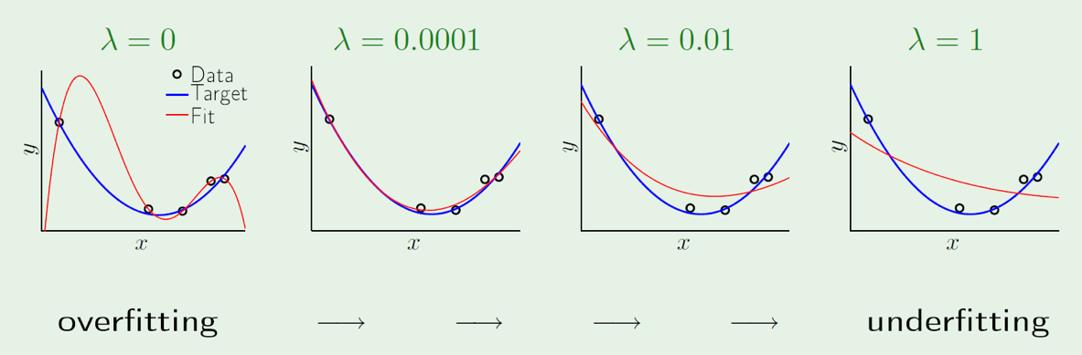
Ridge Regression
The subset selection methods use OLS to fit a linear model that contains a subset of the predictors.
As an alternative, we can fit a model containing all p predictors using a technique that constrains or regularizes the coefficient estimates (i.e. shrinks the coefficient estimates towards zero)
Regularization is our first weapon to combat overfitting. It constrains the machine learning algorithm to improve out-of-sample error, especially when noise is present:
where λ is a tuning parameter that controls the amount of shrinkage and is determined separately. When λ increases, the variance decreases and the bias increases. When λ = 0, then the lasso simply gives the OLS fit.

Slide 43
Least Absolute Shrinkage and Selection Operator (Lasso)
Regularization is a process of introducing additional information in order to prevent overfitting. When we have a high degree linear polynomial that is used to fit a set of points in a linear regression setup, to prevent overfitting, we use regularization, and we include a lambda parameter in the cost function.
One significant problem of ridge regression is that the penalty term will never force any of the coefficients to be exactly zero. Thus, the final model will include all p predictors, which creates a challenge in model interpretation.
The lasso has a major advantage over ridge regression, in that it produces simpler and more interpretable models that involved only a subset of predictors as it uses a different penalty term that shrinks some of the coefficients exactly to zero. Thus, it can generate more accurate predictions compared to ridge regression. However, cross-validation can always be used in order to determine which approach is better on a particular data set.

Slide 44
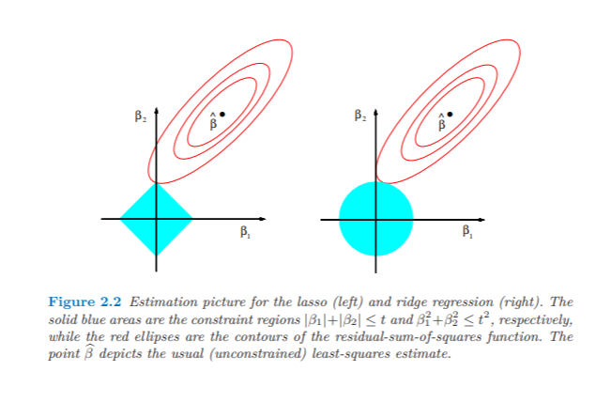
Lasso vs. Ridge Regression
We can see visually how lasso allows B1 to go to zero, while ridge allows B1 to go close to zero, but never reach zero
B1 shrunk to zero
B1 shrunk *close* to, but not exactly, zero

Slide 45
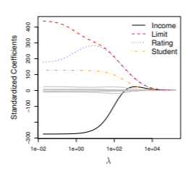
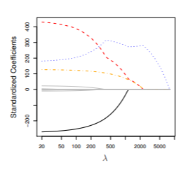
Lasso vs. Ridge Regression
Ridge coefficients are shrunk towards zero, while lasso coefficients are forced to zero
Ridge
Lasso

Slide 46
Lasso Exercises
https://www.r-exercises.com/2017/06/12/lasso-regression-in-r-exercises/?utm_source=rss&amp;utm_medium=rss&amp;utm_campaign=lasso-regression-in-r-exercises

Slide 47
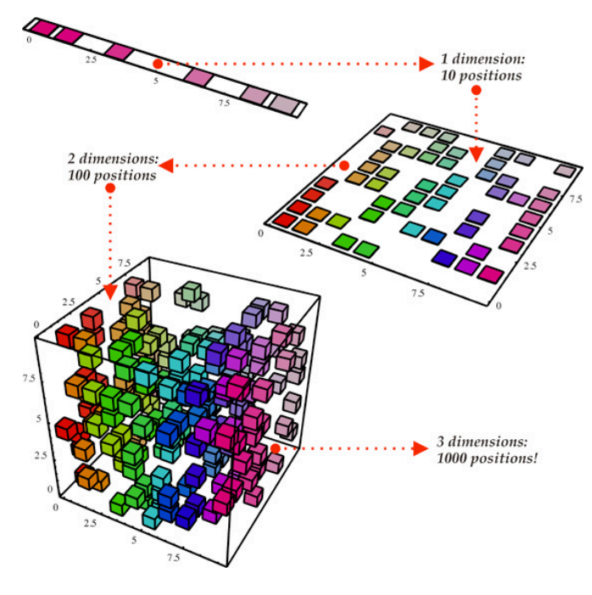
Dimension Reduction
The methods we have discussed so far have involved fitting linear regression models, via OLS or a shrunken approach, using the original predictors.
We now explore a class of approaches that transform the predictors and then fit an OLS model using the transformed variables.
We refer to these techniques as dimension(ality) reduction methods
Dimensionality reduction is the process of reducing the number of random variables under consideration by obtaining a set of principal variables.

Slide 48
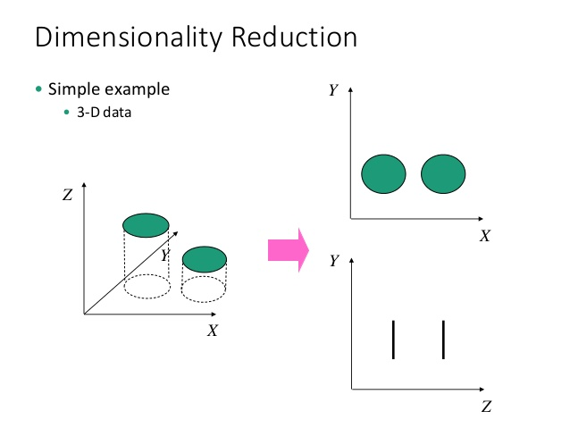
Dimensionality Reduction
Often, the desired goal is to reduce the dimensions of a p-dimensional dataset by projecting it onto a M-dimensional subspace (where M < p) in order to increase the computational efficiency while retaining most of the information. Important question: what is the size of M that represents the data 'well’?

Slide 49
Principal Components Regression (PCR)
PCR is a regression analysis technique that is based on principal components analysis (PCA).
Typically, it considers regressing the response variable on a set of predictors based on a standard linear regression model, but uses PCA for estimating the unknown regression coefficients in the model.
PCA is a statistical procedure that uses an orthogonal transformation to convert a set of observations of possibly correlated variables into a set of values of uncorrelated variables called principal components (eigenvectors).
Each of those eigenvectors is associated with an eigenvalue which can be interpreted as the "magnitude" of the corresponding eigenvector. We reduce the dataset via PCA onto a smaller dimensional subspace by dropping the "less informative" eigenpairs (ones with eigenvalues of smaller magnitude).
This transformation is defined in such a way that the first principal component has the largest possible variance, and each succeeding component has the highest variance possible under the constraint that it is orthogonal to the preceding components.

Slide 50
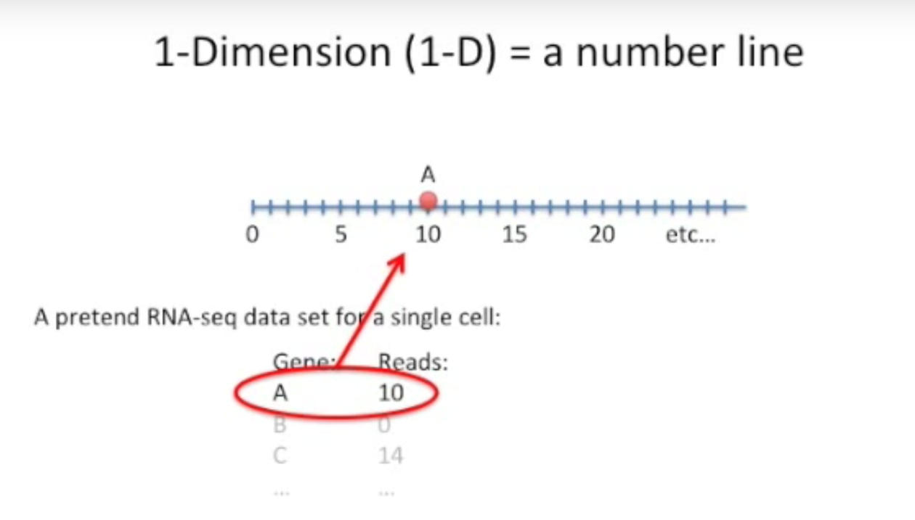
Dimensional Data
PCA is a method for compressing a lot of data into something that captures the essence of the original data but with fewer dimensions. But what is a dimension?
An example of 1-dimension is the number line:

Slide 51
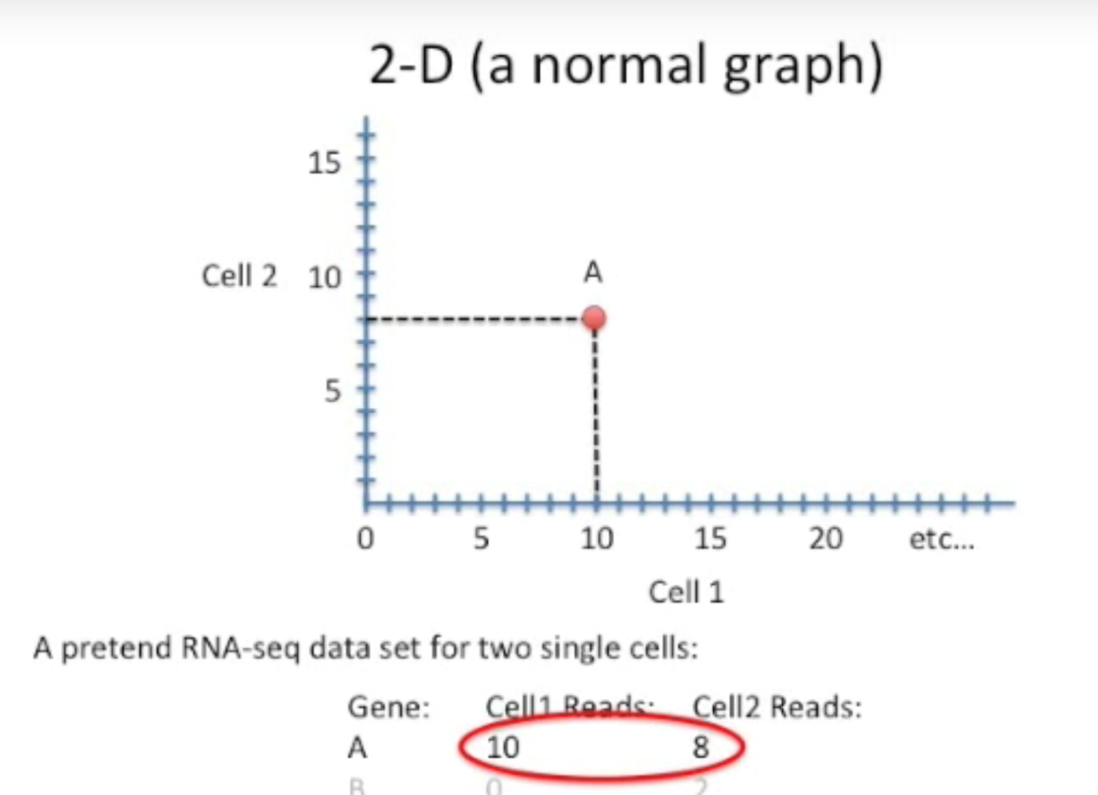
Dimensional Data
An example of 2-dimension is the typical graph:

Slide 52
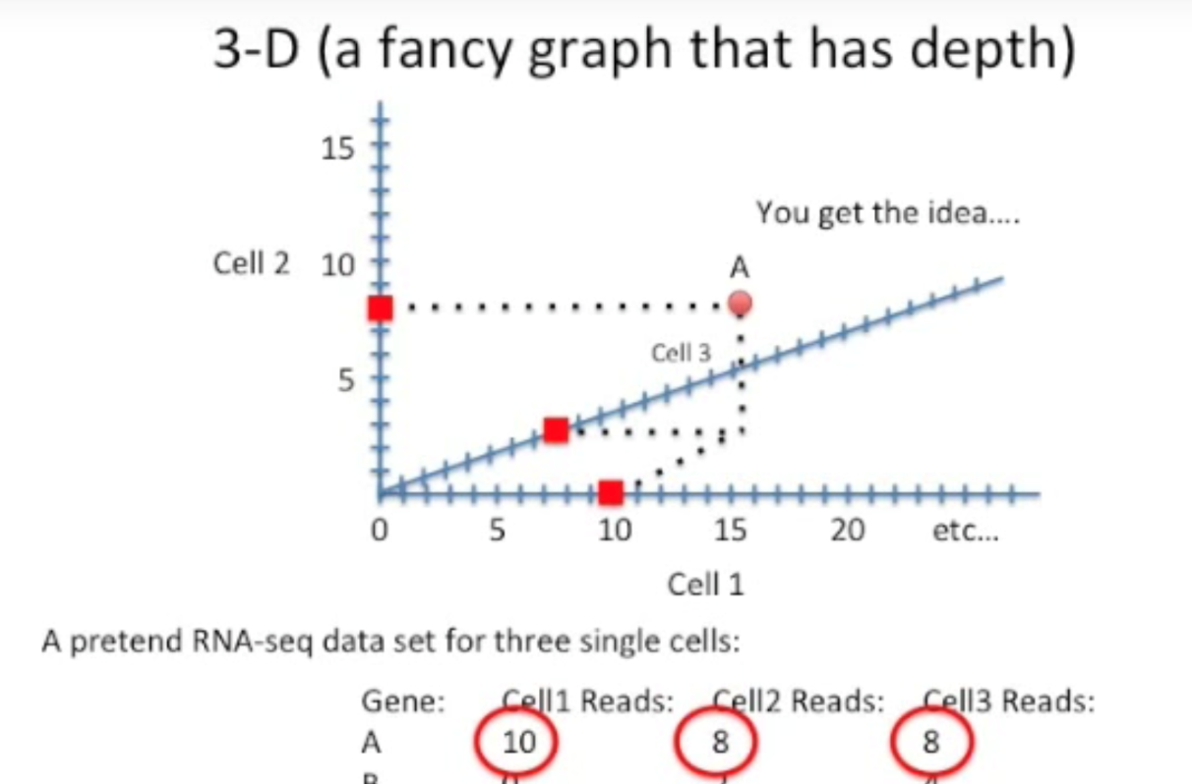
Dimensional Data
An example of 3-dimension is the graph with depth:
But what about 4 and more dimensions? Can we not draw them? Are they not important or common?

Slide 53
Dimensionality Reduction
This is where dimensionality reduction becomes important. But how can we reduce a dimension or more without losing important information?
When we reduce data's dimensionality with PCA, we try to capture maximum variation of data. We transform predictors to be orthogonal – not correlated to each other – and capture most of the variation in the data.
For example, we can always take two-dimensional data and display it in one dimension (example of a graph turned into a number line), as well as we can take 3-dimensional data and display it in 2 dimensions. This is what movies do - we watch 3d objects on 2d TV screens, yet not much information is lost even thought we no longer have the depth.

Slide 54
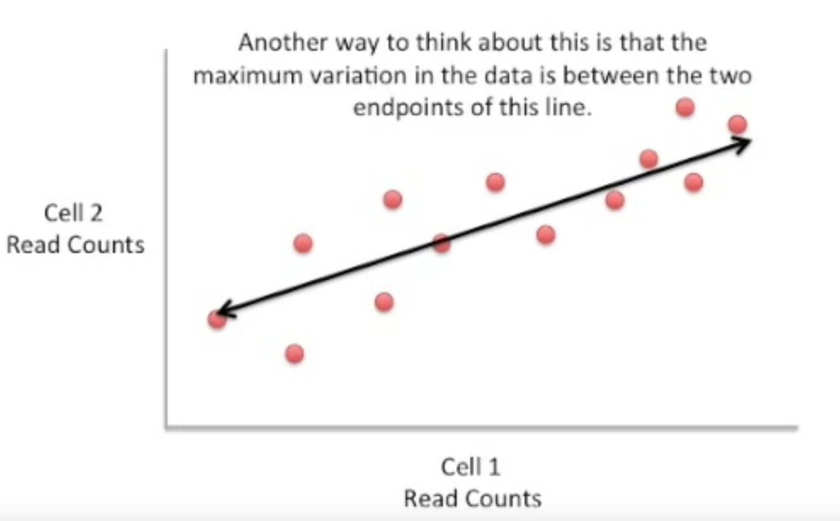
PCA: 1st Principle Component
The first principal component is the linear combination of the variables with the largest variances. Generally, the dots are spread out along a diagonal line, between the two ends of the data, so if we were to pick single direction only that would be the one that's diagonal.

Slide 55
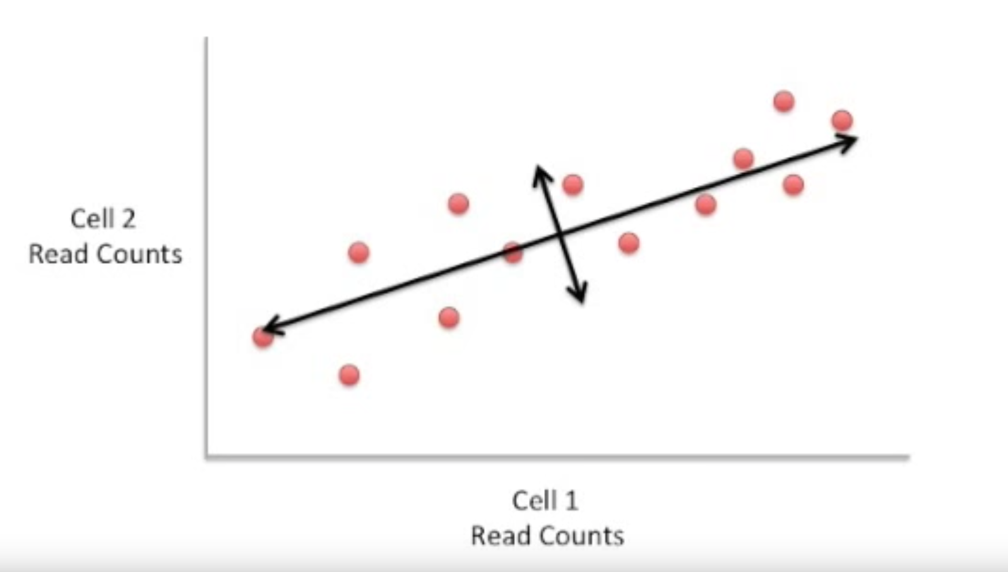
PCA: 2nd Principal Component
The second principal component has largest variance, subject to being uncorrelated with the first….etc.
Generally the dots are also spread out a little above and below the first principal component line.

Slide 56
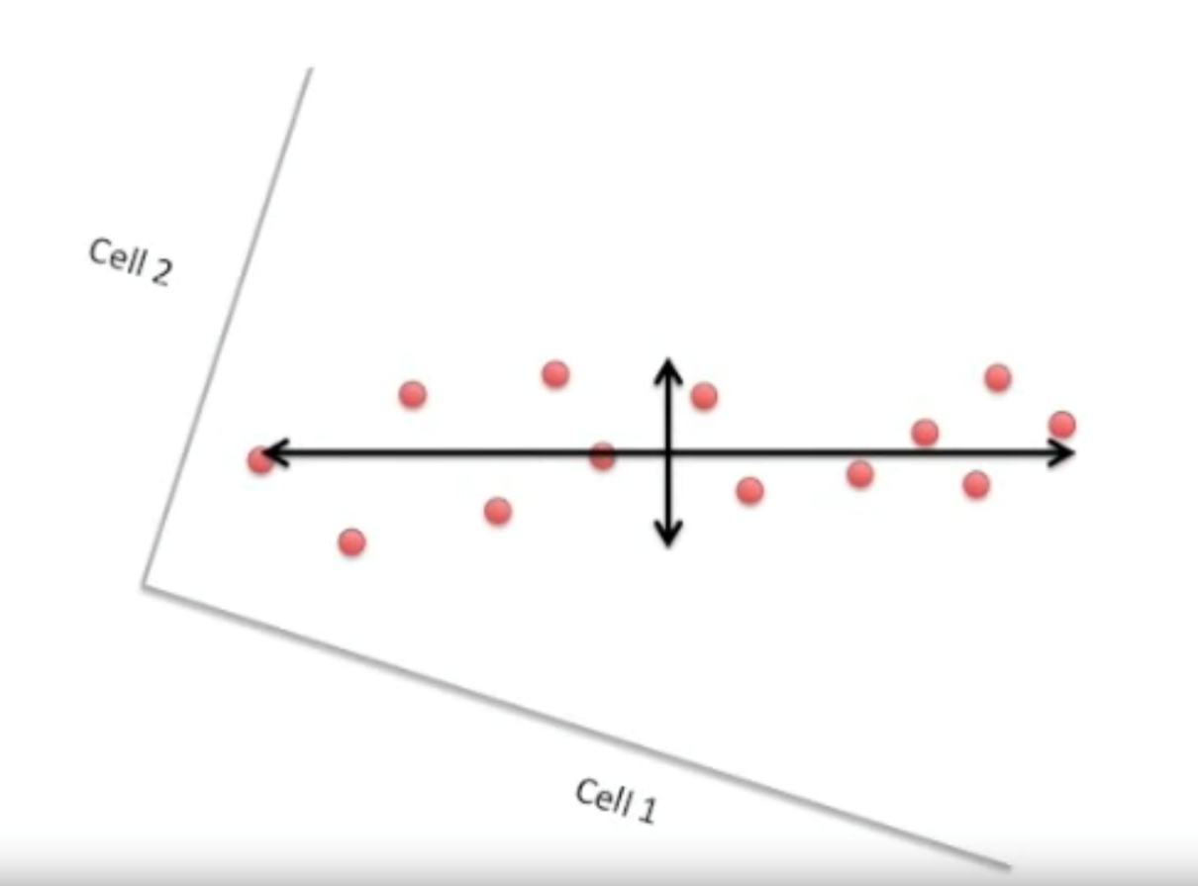
New Axes
If we rotate the whole graph, the two new black lines make new X and Y axes, where left and right variation line becomes 1st PC and up and down line becomes 2nd PC.

Slide 57
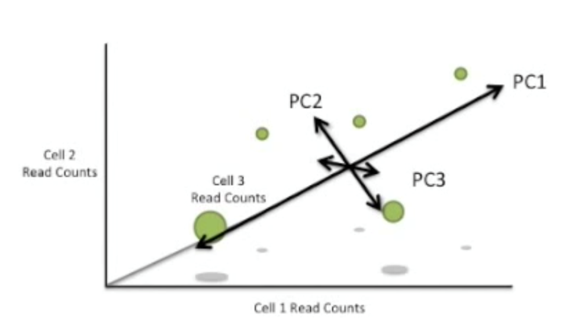
What about 3rd dimension?
Just like before, we would look for the direction of the 3rd most variation.
Thus, with many correlated variables, we replace them with a small set of PCs that capture their joint variation. We assume that the directions that capture most variation are the directions that are most related to Y.

Slide 58
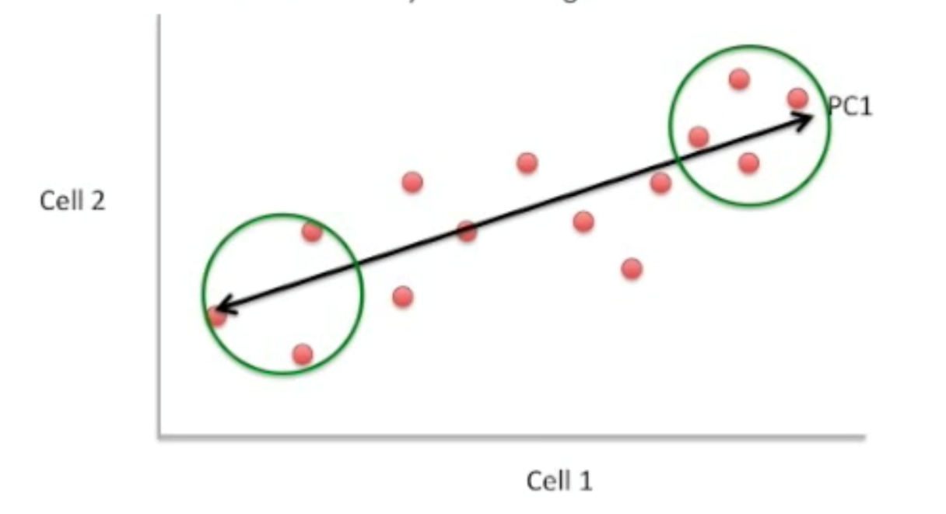
1st Principal Component Details
But how do we calculate these axes?
The length and the direction of PC1 is determined by the extreme data, data in the ends. We then score each data point by the amount of influence they have on PC1. Data at the ends of the line would have high scores, while data points in the middle would have low scores.

Slide 59
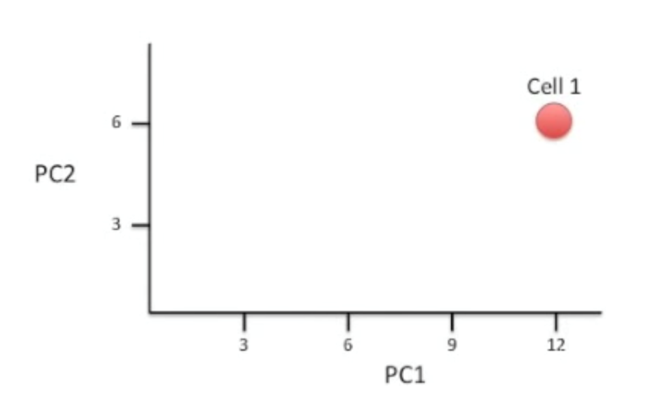
1st Principal Component Details
X1's PC1 score = (X1 value * PC1 influence) + (X2 * PC1 influence). This results in 1 value. This will be our PC1 value.
We do the same for PC2 and so on (we multiply 1st Data point's X value with PC2 influence). This results in 1 value. This is our PC2 value.
Let's say our PC1 value was 12 and PC2 is 6, this will be our new graph.

Slide 60
PCR
So back to PCR: this approach involves using PCA to construct the first M principal components, and then using these components as the predictors in an OLS linear regression model.
The key idea is that often a small number of principal components suffice to explain most of the variability in the data, as well as the relationship with the response.
When performing PCR, predictors should be standardized prior to generating the principal components.

Slide 61
PCR (cont.)
By setting the projection to use principal component directions with the largest eigenvalues and setting PCs with smallest values to 0, dimension reduction is achieved.
PCR is very similar to ridge regression in a certain sense. Ridge regression can be viewed conceptually as projecting the y vector onto the principal component directions and then shrinking the projection on each principal component direction.
The amount of shrinkage depends on the variance of that principal component.
Ridge regression shrinks everything, but it never shrinks anything to zero.
By contrast, PCR either does not shrink a component at all or shrinks it to zero.

Slide 62
PCR (cont.)
PCA tries to find a meaningful way to flatten data by focusing on things that are different between the data points. Each dimension is your predictive variable.
PCR will tend to do well in cases when the first few principal components are sufficient to capture most of the variation in the predictors as well as the relationship with the response.
Note that even though PCR provides a simple way to perform regression using M < p predictors, it is not a feature selection method.
In PCR, the number of principal components is typically chosen by cross-validation or simple things like scree plots to see how much variation each PC can account for. You want to see that the most variation is accounted for by the first two PCs.

Slide 63
PCR Example
http://www.milanor.net/blog/performing-principal-components-regression-pcr-in-r/

Slide 64
Group Project Introduction
As the final assignment in this course, I want you all to be creative, take some risks, and share a project. Therefore, please use the methods (i.e., Regression Analysis, Hypothesis Test, Regularization, Data Mining, and Time Series Analysis) we have learned from the first five modules to analyze a real world data of interest to you with a goal of solving a problem you pose. You may use the supporting links I posted in the module six supporting materials folder.
Please come up with some research questions based on the data you chose and apply the analytical methods you have learned in this course, covered in Modules 1-5. Please prepare a report based on your findings that will include the following information:
a cover page with all the student names in your group, course/section, institution, instructor's name, the assignment title, and the date, a section on the research questions, a section on the data set(s) chosen, a section on the method(s) chosen, a section on results & findings, a section on conclusions, references (if any)
appendix: your R script
Your project should follow APA format. Please approach this as your chance to investigate something of interest to you. You should include images, graphs, figures, charts, and tables as necessary. The deadline will be the last day of class.
If you have any questions, please contact me. However, do not wait until the last day of the assignment's due date to email me with questions/concerns. Start working on it as soon as you can to have a higher chance of success.
I look forward to seeing your creative and analytical work. I know if you put in the effort, you can have some very fascinating results. Work hard!

